Slide 1

Twitter
Sentimental
Analysis
Using NLP
Presentation By-
Dhananjay Daharia
Batch-PGDA24

Slide 2
Contents
01
Introduction
02
Problem Statement
.
03
Data Information
04
.
Challenges
05
Methodology
06
Analysis and Results
07
Conclusion
08
References

Slide 3
Inroduction

Slide 4
What is Sentimental analysis?
Sentiment Analysis is the process of determining whether a piece of writing is positive , negative or neutral
Also referred to as opinion mining , it takes makes our goal to determine whether the data (tweet) is positive , negative or neutral

Slide 5
Why important?
In public opinions eg:
Is the product review positive or negative ?
Is this customer email satisfied or dissatisfied ?
Based on sample of tweets, how are people responding to this ad campaign/product release/item ?
How have bloggers attitudes about the president changed since the election-?

Slide 6
Problem Statement

Slide 7
Problem Statement
The objective of this task is to detect hate speech in tweets. For the sake of simplicity, we say a tweet contains hate speech if it has a racist or sexist sentiment associated with it. So, the task is to classify racist or sexist tweets from other tweets.
Motivation
Hate speech is an unfortunately common occurrence on the Internet. Often social media sites like Facebook and Twitter face the problem of identifying and censoring problematic posts while weighing the right to freedom of speech. The importance of detecting and moderating hate speech is evident from the strong connection between hate speech and actual hate crimes. Early identification of users promoting hate speech could enable outreach programs that attempt to prevent an escalation from speech to action. Sites such as Twitter and Facebook have been seeking to actively combat hate speech.

Slide 8
Dataset
The data contains id, label, and tweet columns. even though the dataset doesn't have any missing values, we have to work a lot on “tweets”
Formally, given a training sample of tweets and labels, where label '1' denotes the tweet is racist/sexist and label '0' denotes the tweet is not racist/sexist, your objective is to predict the labels on the test dataset

Slide 9
Challenges
People express opinions in complex ways
In opinion texts, relatable content alone can be misleading
Intra-textual and sub-sentimental reversals, negation, topic change common
Rhetorical devices/modes such as sarcasm , irony, etc
Unstructured and also non-grammatical
Out of Vocabulary Words
Extensive usage of acronyms like asap, lol, afaik

Slide 10
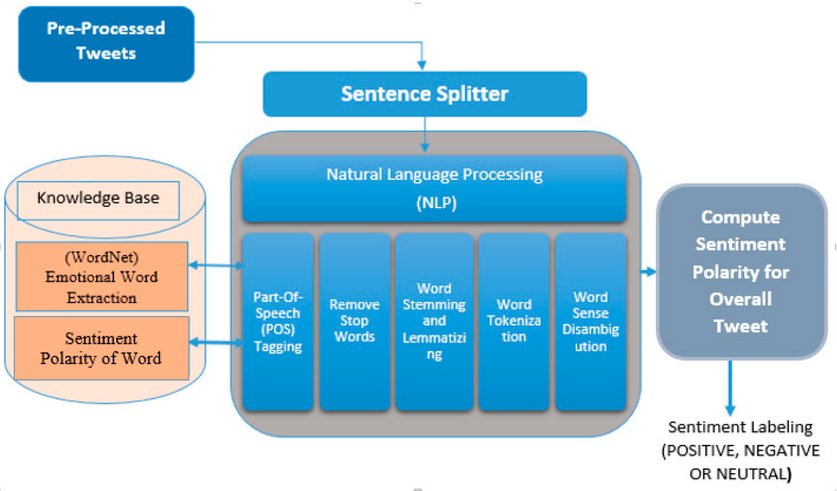
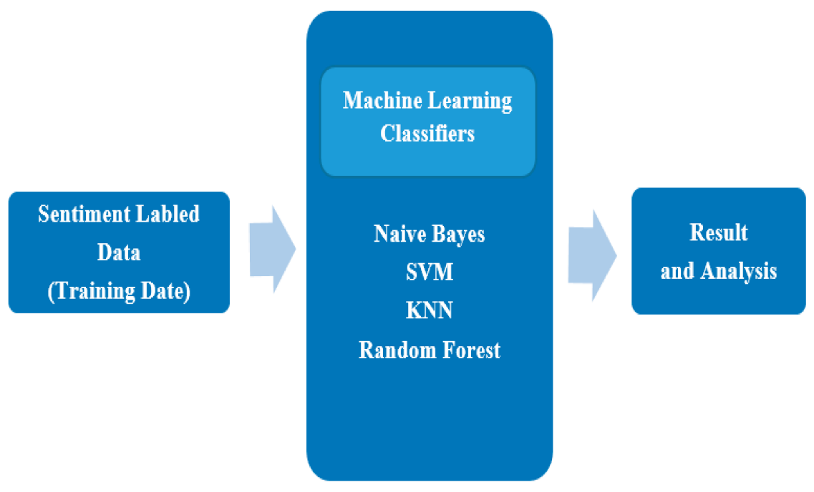
Methodology
Overview of applying ML

Slide 11
Features Extracted and Preprocessed
Positive/Negative Hash Tags
Negations
Special Characters
Repetition word
Acronyms
Stopwords

Slide 12
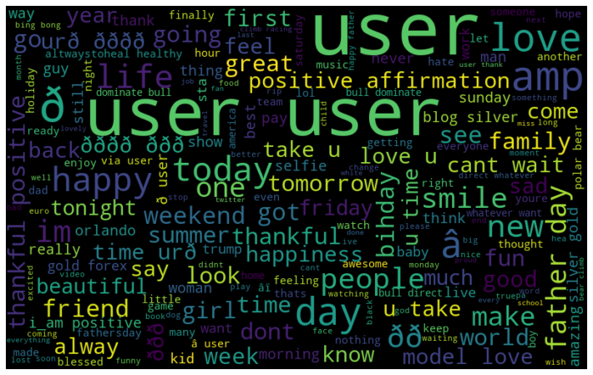
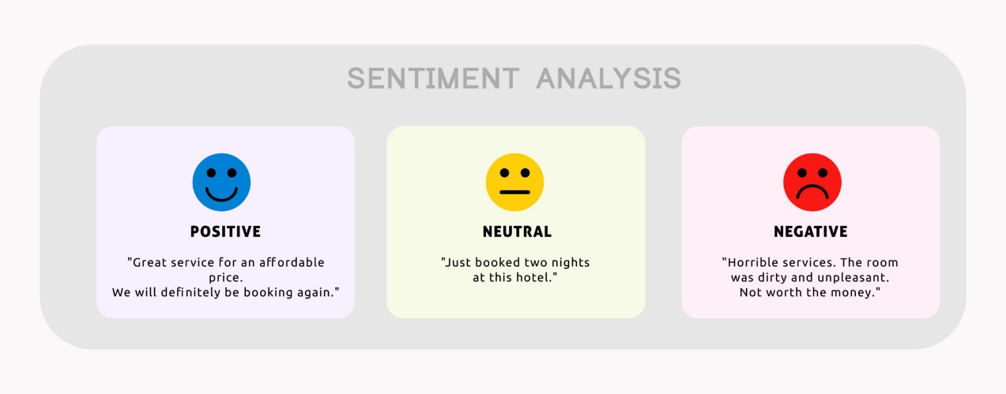

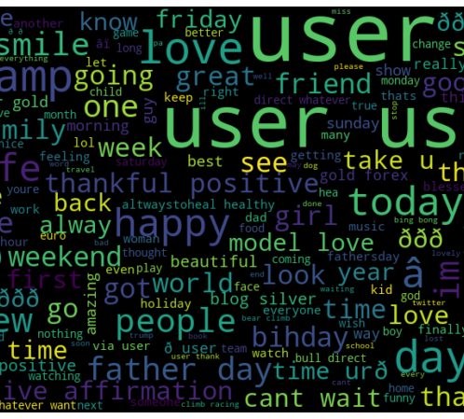
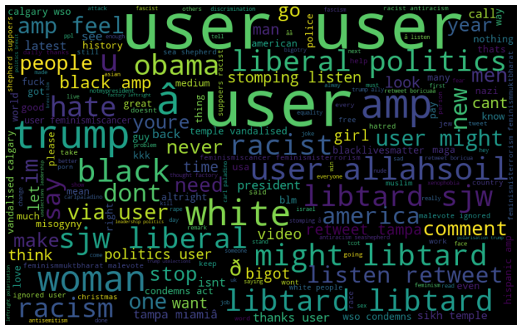
Key Findings in Data
Most frequent words
Most frequent positive words
Most Frequent Negative words

Slide 13
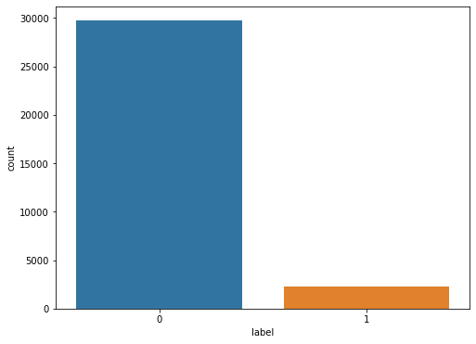
Positive vs Negative Tweets
0 = Positive
1 = Negative
93 %
7 %

Slide 14
Analysis and results
Model | Accuracy(%)
Logistic regression model (count vector) | 94.6
Logistic regression model( Tf-IDF) | 93.39
XGBoost model (count vector) | 94.42
XGBoost Model (TF-IDF) | 94.23
Light GBM Model (count vector) | 94.08
Light GBM Model (TF-IDF) | 94.05

Slide 15
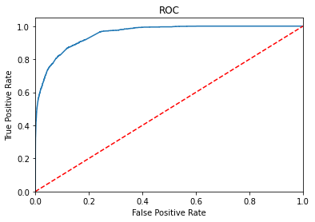
Model | Accuracy(%)
Analysis and results
ROC Curve from Best Model

Slide 16
Conclusions
SOCIAL MEDIA
We conclude that extracting various features and following the both method of Count vectorization and TF-IDF vectorization we got the Xgboost model the best
There is always scope of increasing the accuracy by extracting more featurezs which are relevant for the sentiments and also try more model like Naïve Bayes and more
Increasing the n-gram value to more than 2 does not necessarily increase the accuracyhowever we can try more different models

Slide 17
References
1.www.analyticsvidhya.com/?s=Sentimental+analysis
Neri, F.; Aliprandi, C.; Capeci, F.; Cuadros, M.; By, T. Sentiment analysis on social media. In Proceedings of the 2012 International Conference on Advances in Social Networks Analysis and Mining (ASONAM 2012), Istanbul, Turkey, 26–29 August 2012. [Google Scholar]
Steven, B.; Klein, E.; Loper, E. Natural Language Processing with Python; O’Reilly Media, Inc.: Newton, MA, USA, 2009. [Google Scholar]
Twitter. Available online: https://about.twitter.com/company (accessed on 30 June 2019).
Olsson, F. A Literature Survey of Active Machine Learning in the Context of Natural Language Processing. Available online: https://www.semanticscholar.org/paper/A-literature-survey-of-active-machine-learning-in-Olsson/abebd207b1cf56ced502b0bb203d1f231b58d699 (accessed on 1 April 2009).
Thank You

Slide 18
Thank You

